Slide 1
Lab 2: Analog Circuits
First & Last Name
First & Last Name
ECE 5 Fall 2018

Slide 2
Objective
What is the objective of this lab (in your own words)?

Slide 3
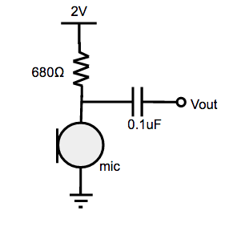

Challenge #1 - Microphone Circuit
Add a clear picture of your circuit
Add a clear picture from your screen for challenge 1 #4 showing the amplitude vs frequency plot while playing note1.wav.
Schematic of Microphone Circuit
Briefly describe your circuit.
Explain your plot. What is the “frequency domain”? What is the fundamental frequency of each signal (note1.wav and note2.wav)? To help you distinguish the fundamental frequency form the noise, it is important to play the notes loudly.

Slide 4
Quick guide on plotting in logarithmic scale (Delete for submission)
Challenge 2-5 requires you to collect data and plot in logarithmic scale.
In this following slides (5-9), we will go over how to do this in Excel, Google Sheets, and MATLAB.
You can use whichever tool you prefer. No need to fill in anything to slides 5-9.

Slide 5
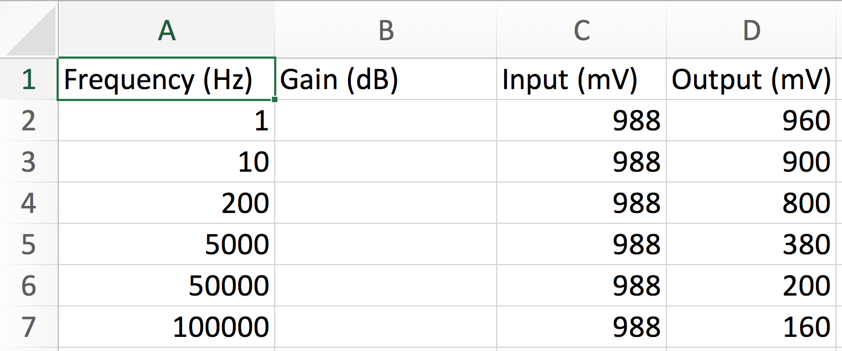
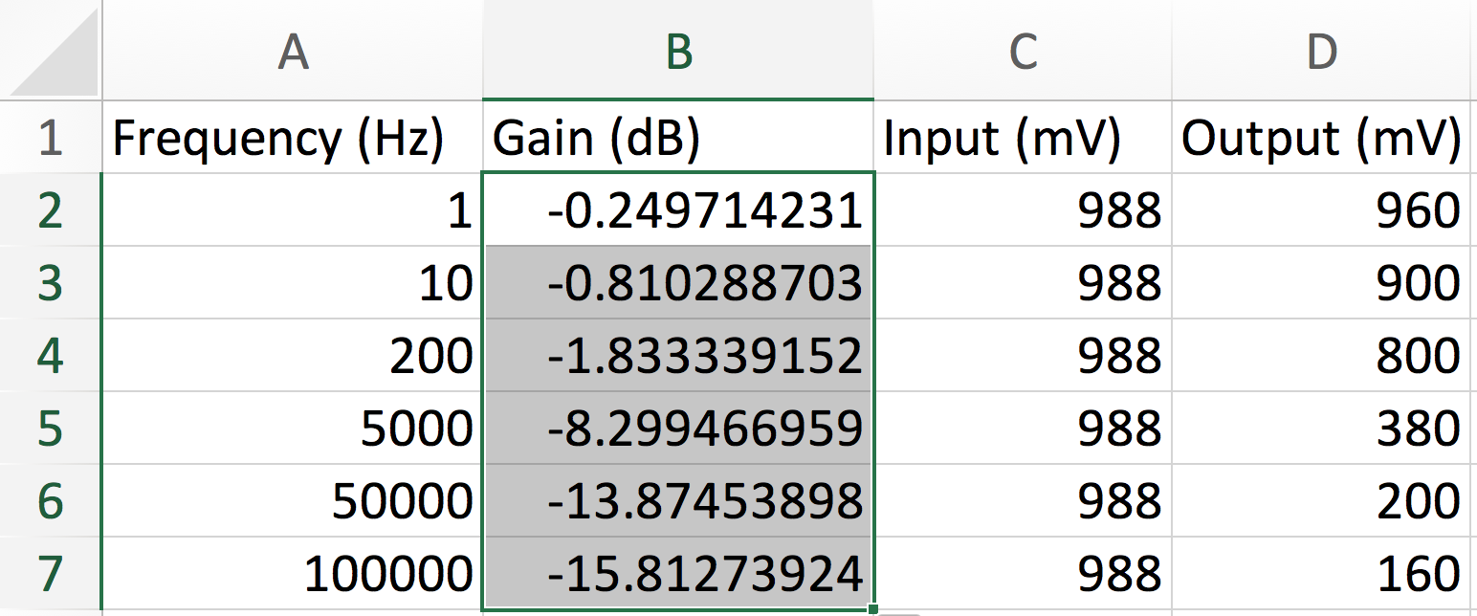
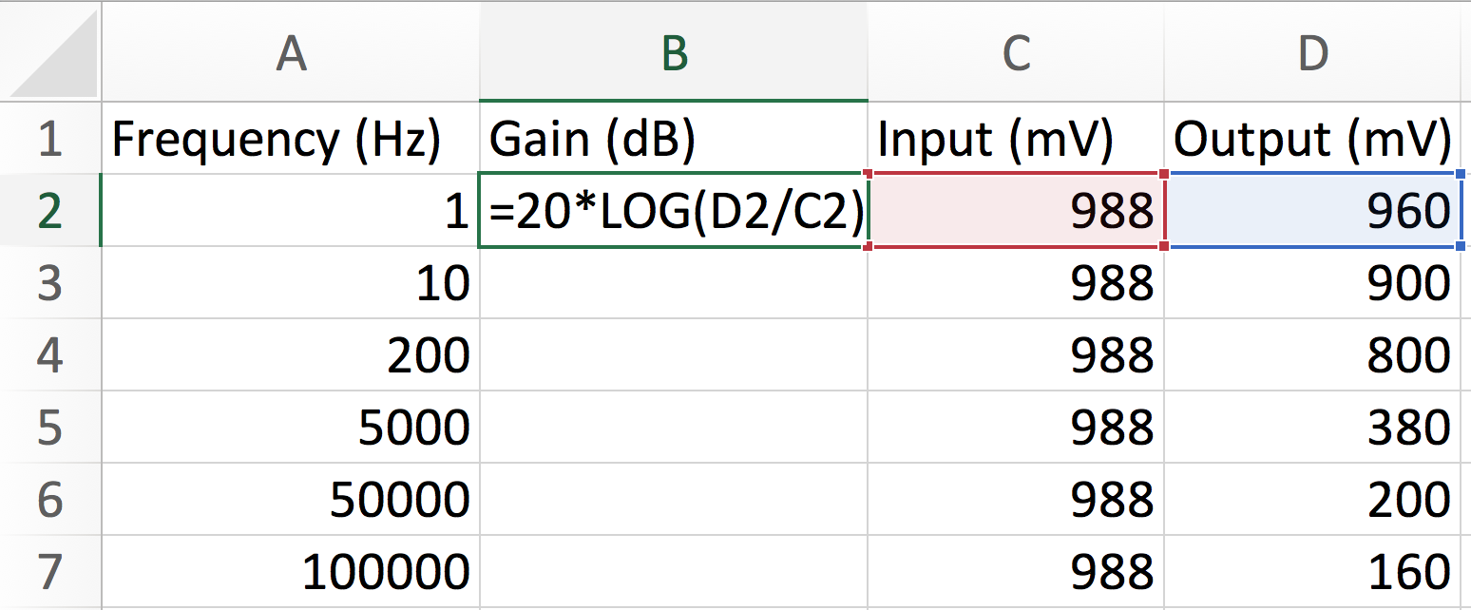
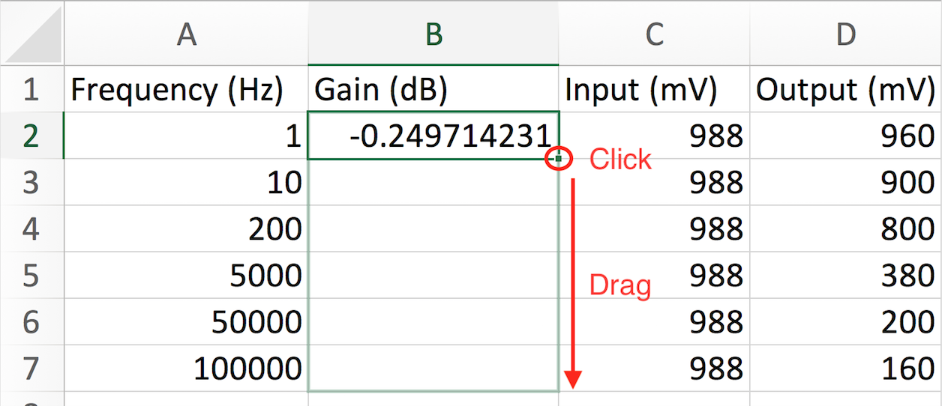
Plotting in logarithmic scale using Excel – 1 (Delete for submission)
1. Input your Frequency, Output, and Input into Excel, then type in the formula to calculate Gain. Drag down from the buttom right of the first cell to auto-complete

Slide 6
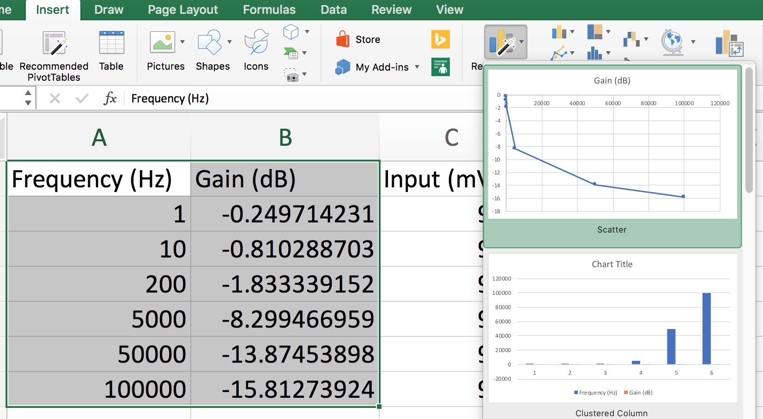
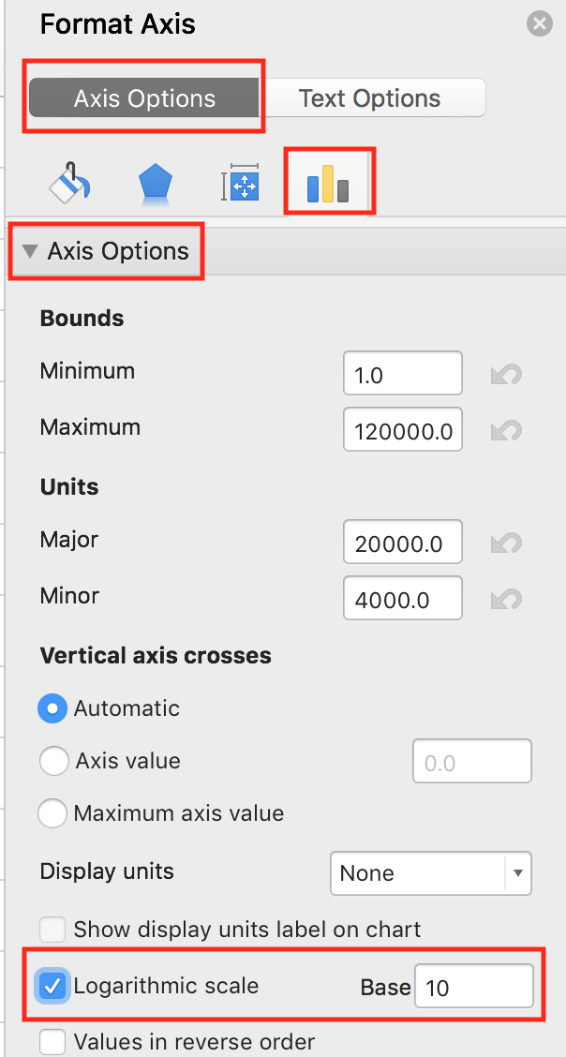
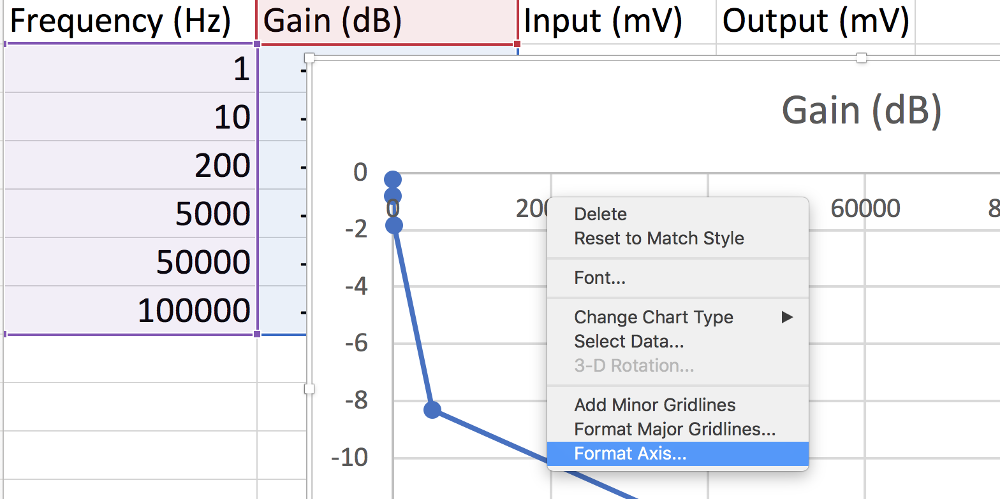
Plotting in logarithmic scale using Excel – 2 (Delete for submission)
2. Choose the columns, then go to Insert – Recommended Charts – Scatter
3. Right click a number on x-axis, and choose Format Axis
4. Unider Axis Options, check Logarithmic scale (with base 10)

Slide 7
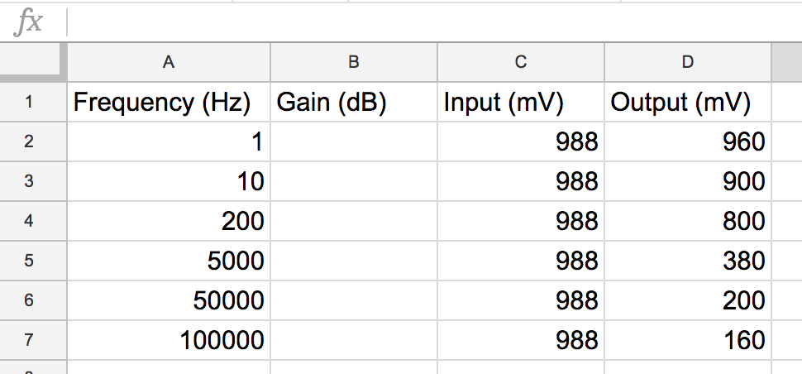
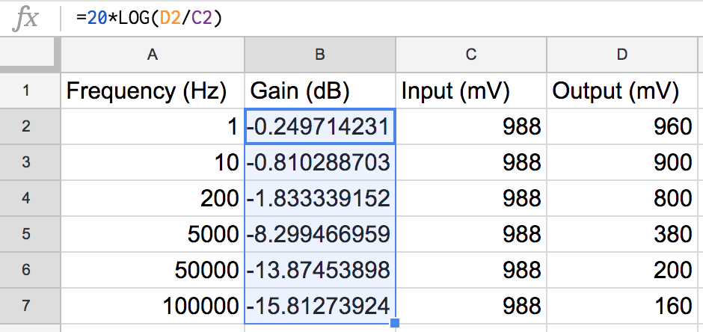
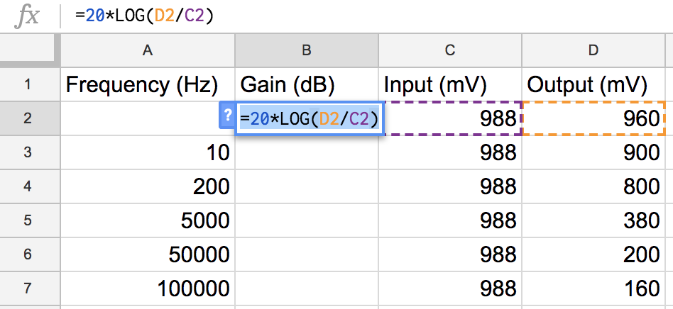
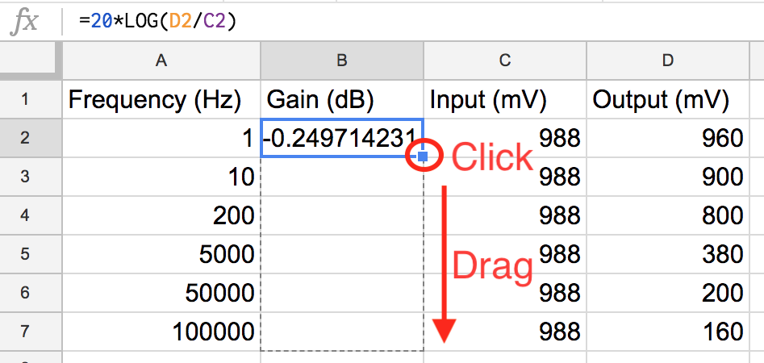
Plotting in logarithmic scale using Google Sheet – 1 (Delete for submission)
1. Input your Frequency, Output, and Input into Google Sheet, then type in the formula to calculate Gain. Drag down from the buttom right of the first cell to auto-complete

Slide 8
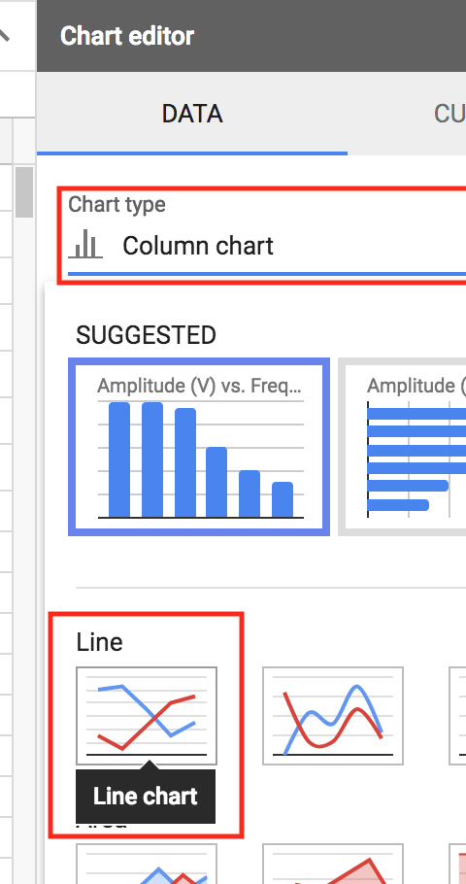
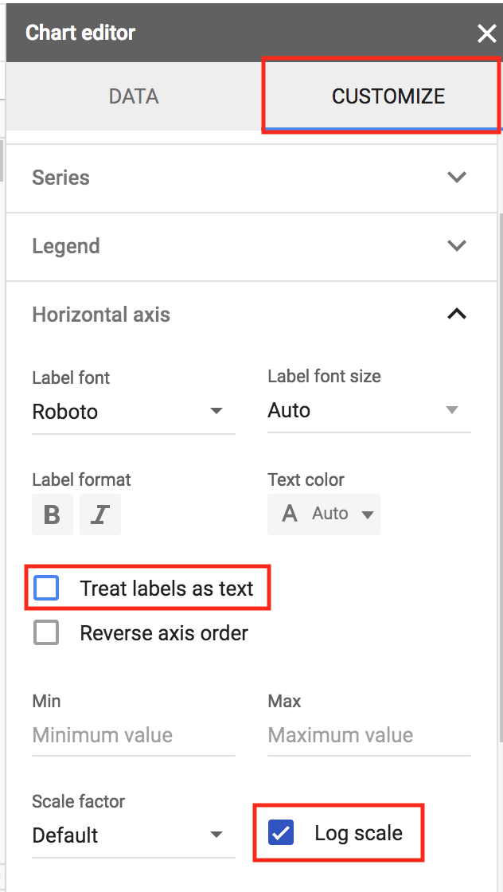
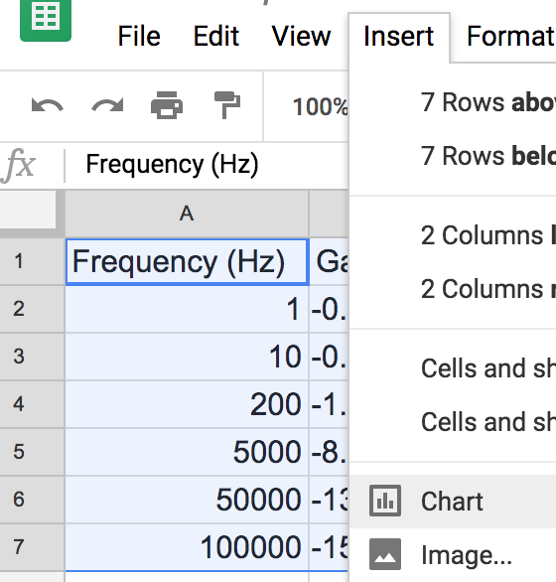
Plotting in logarithmic scale using Google Sheet – 2 (Delete for submission)
2. Choose the two columns, then go to Insert – Chart to plot the data
3. In the Chart Editor that opens up, click Chart type and choose Line chart
4. Click CUSTOMIZE, uncheck Treat labels as text, then check Log scale

Slide 9
Plotting in logarithmic scale using MATLAB (Delete for submission)
freq = [1,10,200,5000,50000,100000]; % Frequency data goes here
in = [988,988,988,988,988,988]; % Input amplitude goes here
out = [960,900,800,380,200,160]; % Output amplitude goes here
gain = 20*log10(out./in); % Calculates gain
semilogx(freq,gain,'-*') % Plots in log scale, x-asis is freq, y-axis is ampl
title('Frequency vs. Amplitude plot for xxx') % Titles of the plot
ylim([-20,0]) % Sets the range of y-axis
xlabel('Frequency (Hz)'), ylabel('Gain (dB)')

Slide 10
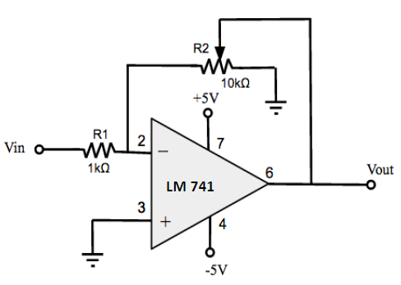
Challenge #2 - Amplifier
Add a clear picture of your circuit
Create and add a plot from data you collected with gain (dB) on y-axis and frequency (Hz) on x-axis. Plot in the logarithmic scale using the tool you prefer.
Schematic of Amplifying Circuit
Briefly describe your circuit.
Explain your plot. What is an amplifier? What is the relationship for the gain (𝐴𝑣 = 𝑣𝑜/𝑣𝑖) as a function of the two resistor values 𝑅1 and 𝑅2 (How do resistor values affect the gain?)? Does an amplifier have a cut off frequency?

Slide 11
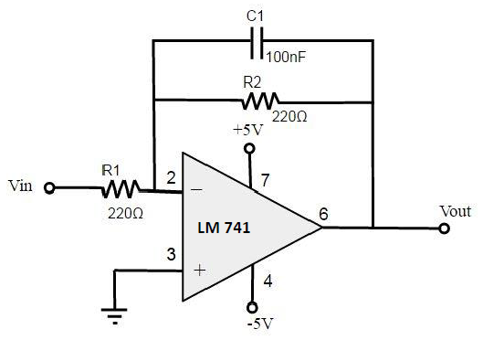
Challenge #3 - Low Pass Filter
Add a clear picture of your circuit
Create and add a plot from data you collected with gain (dB) on y-axis and frequency (Hz) on x-axis. Plot in the logarithmic scale using the tool you prefer.
Schematic of Low-Pass Filter
Briefly describe your circuit.
Explain your plot. Estimate the cutoff frequency of this filter. Why is this called a “low-pass” filter?

Slide 12
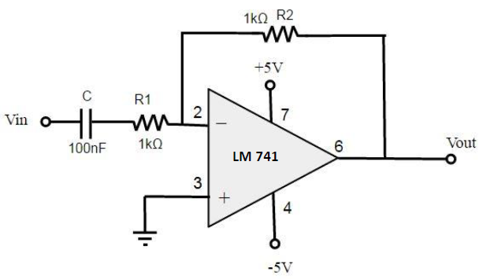
Challenge #4 - High Pass Filter
Add a clear picture of your circuit
Create and add a plot from data you collected with gain (dB) on y-axis and frequency (Hz) on x-axis. Plot in the logarithmic scale using the tool you prefer.
Schematic of High-Pass Filter
Briefly describe your circuit.
Explain your plot. Estimate the cutoff frequency of this filter. Why is this called a “high-pass” filter?

Slide 13
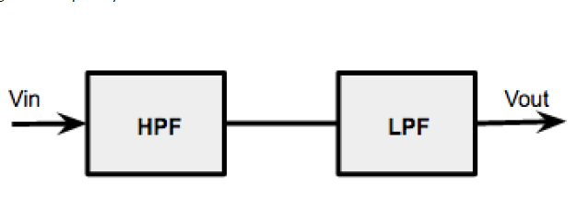
Challenge #5 - Band Pass Filter
Add a clear picture of your circuit
Create and add a plot from data you collected with gain (dB) on y-axis and frequency (Hz) on x-axis. Plot in the logarithmic scale using the tool you prefer.
Block diagram of Band Pass Filter
Briefly describe your circuit.
Explain your plot. What is a band pass Filter. What are the cutoff frequencies and what is the band width?

Slide 14
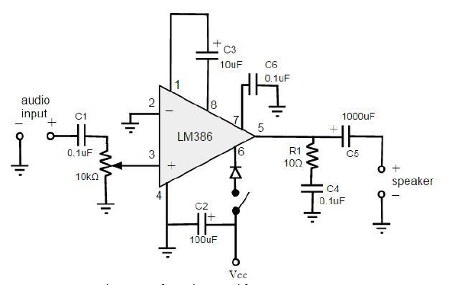
Challenge #6 - Audio Amplifier
Show a picture of your breadboarded circuit being connected to the virtual bench for testing (function generator with o-scope channel 1 used as your audio input and o-scope channel 2 connected to your audio output)
Schematic of Audio Amplifier Circuit
Show a screen shot of your virtual bench interface screen illustrating your signals input (ch1) and output (ch2)
Add a picture of your breadboarded circuit

Slide 15
Challenge #6 - Audio Amplifier
Add a clear picture of your soldered Circuit. (remember to submit a video of your circuit working)
Schematic of Audio Amplifier Circuit
Briefly describe your circuit, how you tested it, and some of the problems that came up while building this.

Slide 16
Lab Equipment and Experience
Explain the purposes for each of the following lab equipment: multimeter, power supply, oscilloscope, function generator?
What was most valuable to you in this lab? Did you extend beyond the required challenges using what you have learned or did you have further questions regarding how something worked?Any other pictures you or ideas of projects or things you would like to share from your second lab?

